Slide 1
Design a simple HTTP client-server communication in any language.

Slide 2
An HTTP client-server communication is a request-response protocol that allows two computers to exchange data over a network. Think of it like a customer (client) ordering food from a kitchen (server).
The Concept Diagram
In this model, the two entities have distinct roles:
The Client (Service Requester): Usually a web browser or a mobile app. It triggers the communication by asking for a specific resource.
The Server (Service Provider): A powerful computer that sits waiting for requests. It stores data and "serves" it when asked.

Slide 3
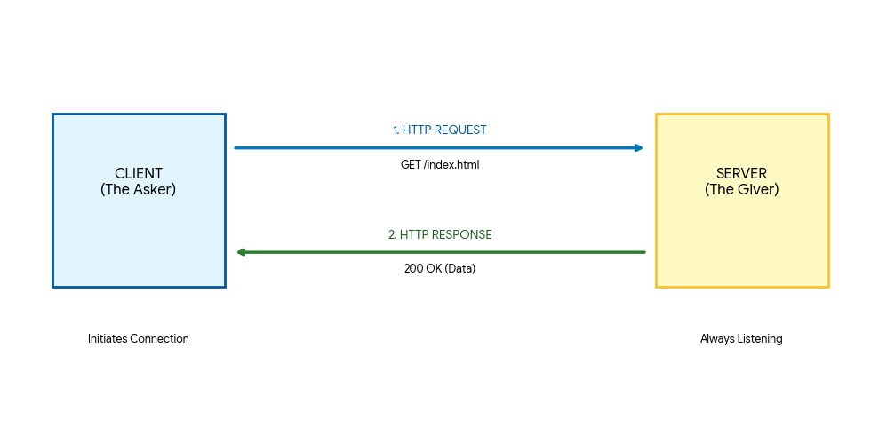

Slide 4
The Three Core Stages
Establishment: The client looks up the server's address (IP) and opens a "pipe" (TCP connection) to talk through.
The Request: The client sends a specific message. This message contains a Verb (like GET to see data or POST to save data) and a Path (where the file is located).
The Response: The server looks at its files, processes the logic, and sends back a message. This always includes a Status Code (like 200 for "Success" or 404 for "Not Found") and the actual data (HTML, image, or text)

